Slide 1
College Student Mental Health:
Distressed Students and how to Help Them
Josette Cline, Ph.D., Director
Counseling and Psychological Services (CAPS)
Pat Walker Health Center

Slide 2
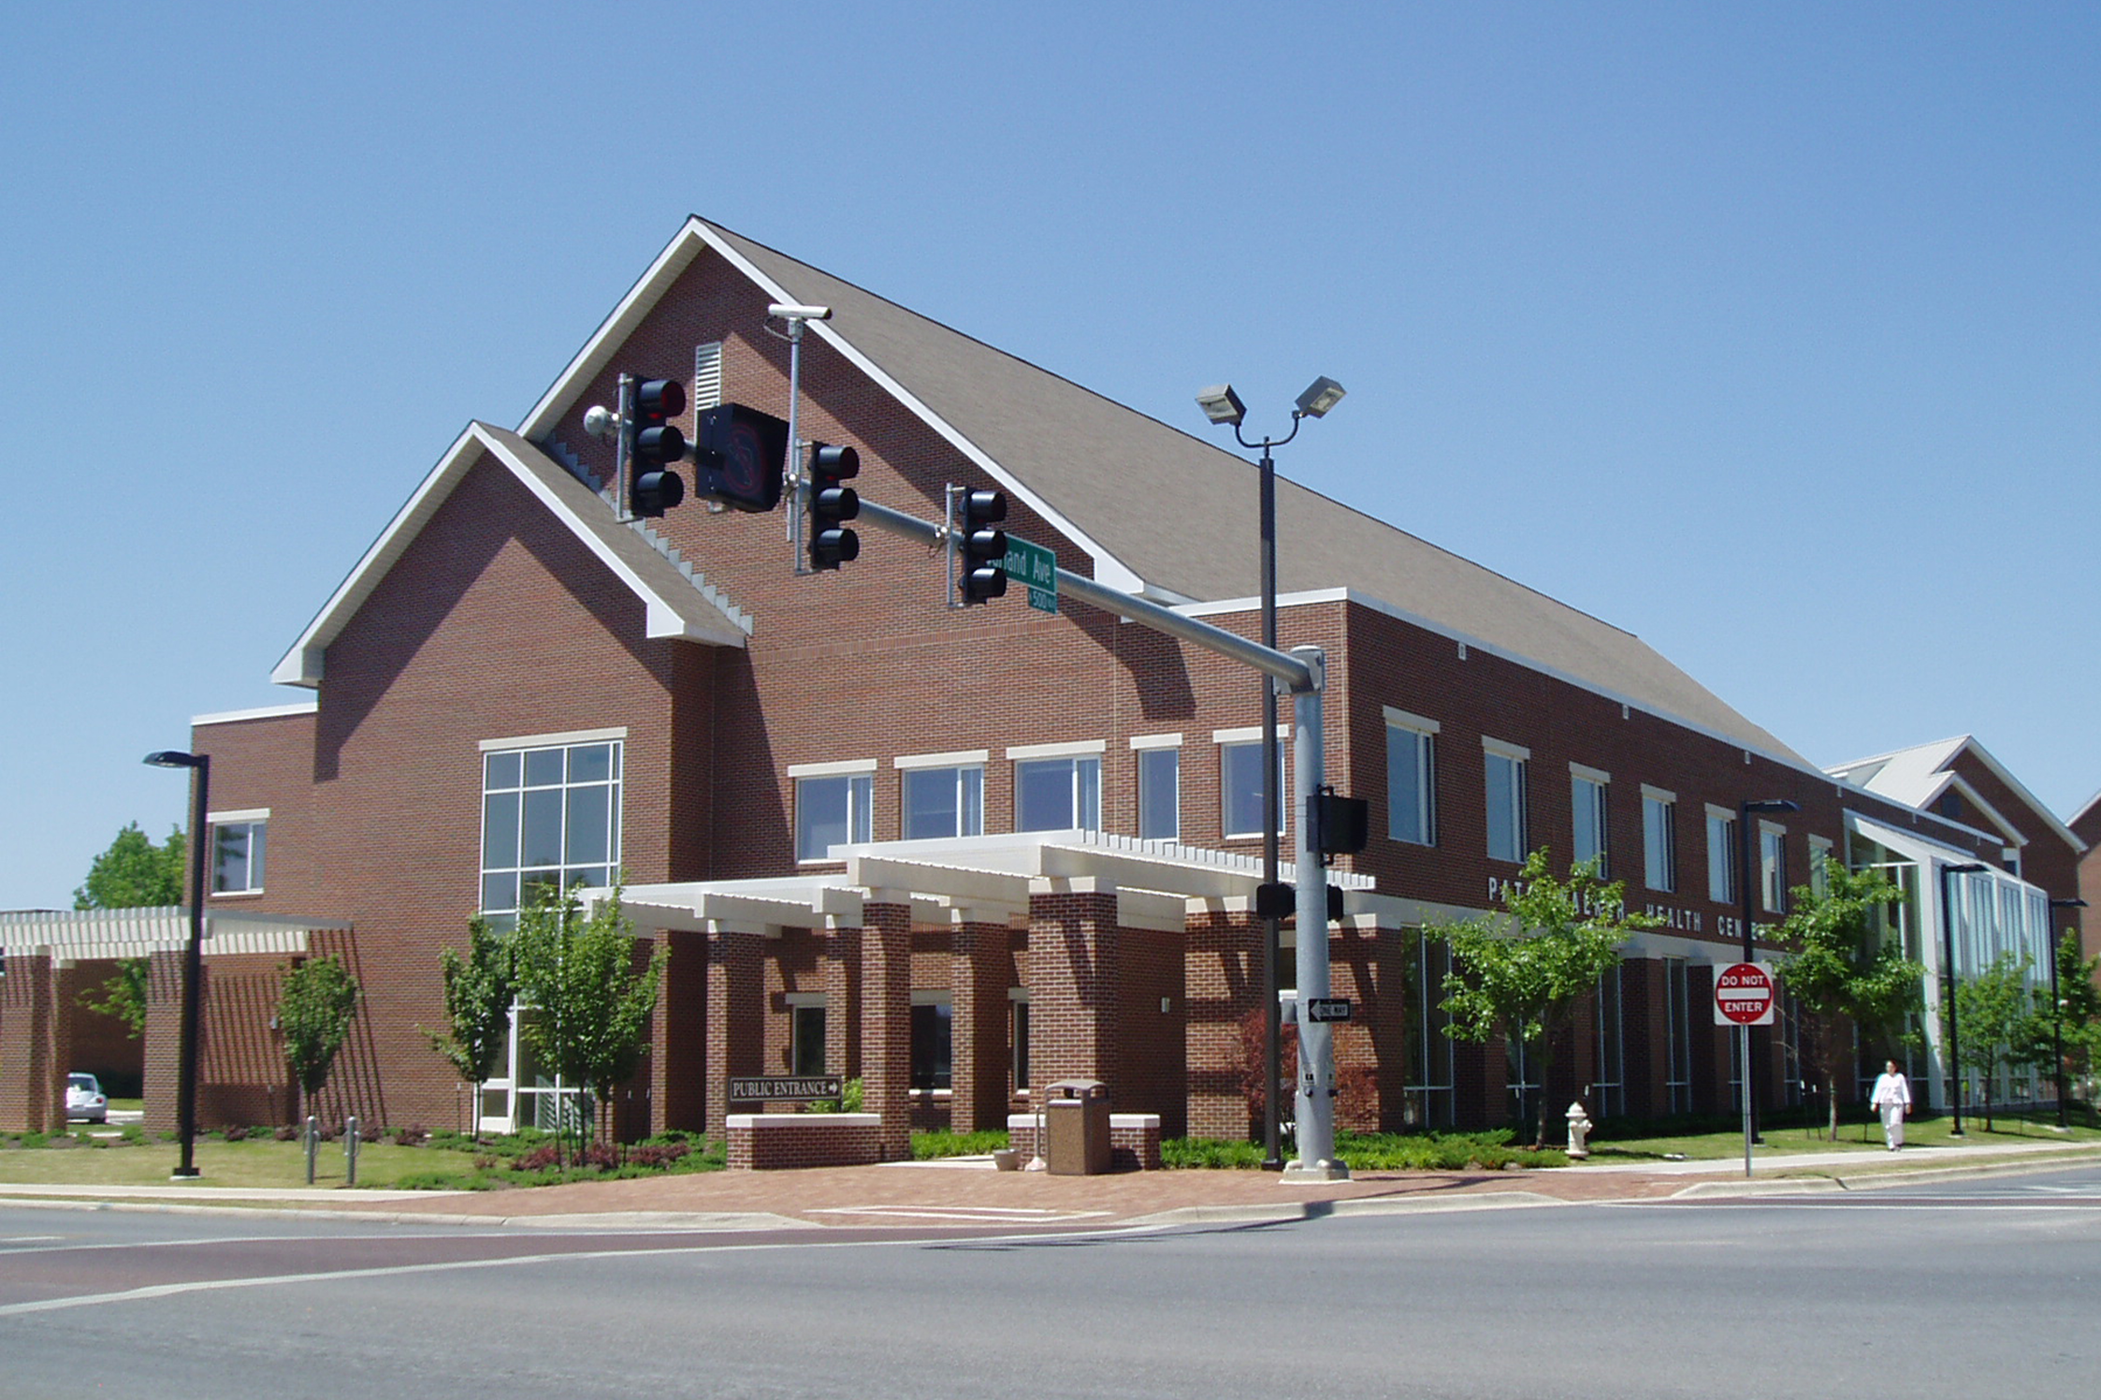
Counseling and Psychological Services (CAPS), Pat walker health center

Slide 3
Purpose and Mission of CAPS
To provide quality mental health services to the University of Arkansas community which will increase the retention and graduation rates of our students, support our faculty and staff, and reduce the risk of adverse events.

Slide 4
What Services Does CAPS Offer?
Emergency Services Psychiatry
Intake/Assessments Case Management
Individual Therapy Outreach and Prevention
Group Therapy
Clinical Consultation Services (RazorCat team, Threat Assessment Team)

Slide 5
CAPS Staffing…
CAPS Clinical Personnel 2016/2017
3 FTE Psychologists
4.6 FTE Counselors
4.2 FTE Social Workers
1.1 FTE Psychiatry
1 FTE Psychiatric Nurse
Total FTE 13.9
All hold a Masters Degree, Ph.D., or M.D. and are licensed in their field.
We have a Graduate Clinician training program during the academic year.

Slide 6
U of A Enrollment 1985 to 2014…expansion!

Slide 7
Center for Collegiate Mental Health (CCMH): Trends over the last 6 years…
Growth in number seeking services was more than 5x the rate of growth in institutional enrollment nationally
Students are more likely to endorse “threat to self” behaviors than at any time in the past, increasing the need for emergency evaluations
Students reporting “threat to self” use an average of 27% more services
“Rapid Access” appointments increase while “routine” decrease
Notes:
THREAT TO SELF = NSSI, ideation and attempts
In 2015 26.5% of our clients at CAPS were seen for 6 or more appointments, the average # of attended appts is 5 (4.74)

Slide 8
The national picture…
According to the Center for Collegiate Mental Health’s (CCMH) 2016 Annual Report:
1 out of 4 students seen at a counseling center has self-injured
1 out of 3 has considered suicide
Nearly 1 out of 10 has made a suicide attempt
1 out of 10 has been hospitalized for psychiatric reasons
Notes:
140 centers, 101,027 students, 770,000 appointments with 2,770 clinicians

Slide 9
“Top 5” presenting concerns…
Anxiety
Depression
Stress
Family
Academic performance
Notes:
140 centers, 101,027 students, 770,000 appointments with 2,770 clinicians

Slide 10
CAPS Trends – Self-Injury
(238)
(290)
(307)
(354)
Notes:
Based on SDS which looks a lifetime

Slide 11
CAPS Trends – Prior Hospitalizations
(32)
(75)
(104)
(111)
Notes:
Based on SDS which looks a lifetime

Slide 12
CAPS Trends – Seriously Considered Suicide (1 or more times, lifetime)
(304)
(384)
(402)
(479)
Notes:
Based on SDS which looks a lifetime

Slide 13
CAPS Trends – Attempted Suicide
(45)
(87)
(122)
(127)
Notes:
Based on SDS which looks a lifetime

Slide 14
CAPS Trends – Seriously considered attempting suicide within the last 2 weeks
(52)

Slide 15
The Climate of Suicide on Campus
Suicide now ranks as the 2nd leading cause of death among 15-24 year olds and 25-34 year olds.
It is estimated that 1,100 completed suicides occur on college campuses each year.

Slide 16
So How Can You Help?

Slide 17
Kognito – Identify and Refer Distressed Students
AT-Risk for Higher Education is utilized by more than 300 colleges and universities across the country
Includes two, 30-45 minute online suicide prevention and gatekeeper training simulations.
One for Faculty and Staff
One for Students

Slide 18
Kognito – Goals…
Build skills and motivation to identify, approach and refer students in distress to relevant support services on and off campus.
Reduce stigma about mental disorders and increase recognition that suicide prevention is everyone’s responsibility.
Increase help-seeking behaviors among students and reducing negative attitudes for seeking care.
Building knowledge about on and off campus behavioral health services.

Slide 19
Now for some good news…
72% of survey respondents reported that their experience at CAPS allowed them to be more successful academically
(CAPS Client Survey, Spring, 2016)
Notes:
Spring 2015 Survey, sent to 328 with 80 responses, a 25.1% return rate

Slide 20
79% reported that coming to CAPS positively affected the chances that they would stay in school and graduate from U of A

Slide 21
16% reported that they likely would have withdrawn for mental health reasons if they had not gone to CAPS
Notes:
29% of 80 students = 23.2 students, and these were just students seen by CAPS in March, 2015

Slide 22

Questions?

