Slide 1
New Faculty Orientation
Welcome
You are Valuable!

Slide 2
Welcome
Office of Faculty Affairs
Anna Zajicek, Ph.D. & Stephanie G. Adams Ed.D.
Vice Provost of Faculty Affairs & Director of Faculty Development

Slide 3
What New Faculty Need to Know Now
Faculty Collaborative
Advance ENGAGE Bridge Program
Peer Mentoring Circles
Travel Award Program
National Center for Faculty Development & Diversity Website
Resources page on Faculty Affairs website

Slide 4
What New Faculty Need to Know Later
Mentoring Graduate Students & Postdocs Workshop Series
NSF ADVANCE ENGAGE Leadership Development Program
Council of Chairs - leadership development workshops for chairs and department heads

Slide 5
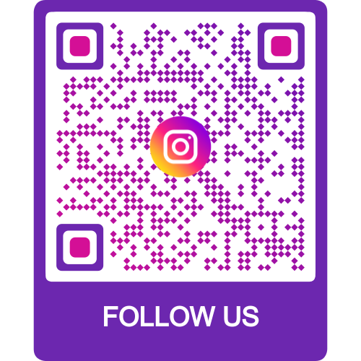
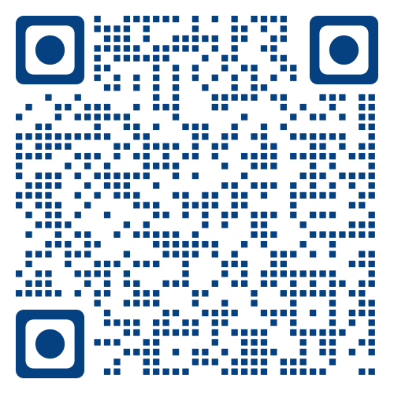
Handout of Resources
Anna Zajicek Interim Vice Provost for Faculty Affairs azajicek@uark.edu
Stephanie G. Adams
Director of Faculty Development sgadam@uark.edu
Faculty Affairs Website https://facultyaffairs.uark.edu/
UA ADVANCE ENGAGE Website https://uaengage.uark.edu/
National Center for Faculty Development & Diversity https://www.facultydiversity.org/

Slide 6
We Are Here for You
Teaching and Faculty Support Center Carole Shook Lynn Meade Don Johnson
Richard Cassady
Lori Libbert

Slide 7
Teaching and Faculty Support Center What New Faculty Need to Know Now
New Faculty Resources
Lunch Programs
Commendations
Membership and Journals

Slide 8
Teaching and Faculty Support Center What New Faculty Need to Know Later
Awards and Awards Banquet
Grants
Teaching Camp
Peer Observation
Winter Teaching Symposium

Slide 9
Wally Cordes Teaching and Faculty Support Center Handout
Teaching and Faculty Support Website
All Resources are on the Web
https://teaching.uark.edu/
Event Photos and Program Reminders on Social Media. Like us on Facebook!

Slide 10
Welcome
Division of Diversity, Equity, and Inclusion
Yvette Murphy-Erby, PhD, MSW
Vice Chancellor for DEI

Slide 11
What New Faculty Need to Know Now
Diversity, Equity, and Inclusion is one of the top priorities for our campus.
We believe that DEI should be embedded in all that we say and all that we do.
You can become a diversity champion by visiting our website and registering.

Slide 12
What New Faculty Need to Know Later
Our office is here to help and support your efforts. We hold office hours everyday that classes are in session.
Anyone with a UARK email address can request an office hour appointment to talk about anything related to DEI by emailing diversity@uark.edu to request a time.

Slide 13
Handout of Resources Diversity, Equity, and Inclusion
Home | Division of Diversity, Equity and Inclusion | University of Arkansas (uark.edu)
IDEALS Institute | Harness the power of diversity. (uark.edu)
"OUCH! That Stereotype Hurts" | Division of Diversity, Equity and Inclusion | University of Arkansas (uark.edu)

Slide 14
Diversity
Watch first 2:36

Slide 15
Getting to Know the U of A
What was the original mascot?
What is the Razorbug?
What is the spoofer’s stone known for?
What is the oldest class on the Senior walk?
How many faculty at the U of A?

Slide 16
University of Arkansas Fun Facts

Slide 17
What is Spoofer’s Stone?

Slide 18
What is Spoofer’s Stone
When Old Main was Constructed, a broken stone was left on the lawn.
In early days, when females and males were not allowed to fraternize. Students would pass notes putting them in the crack.
Popular place for proposals.

Slide 19
The Senior Walk
More than 200,000 University of Arkansas graduates
Oldest class 1876

Slide 20
Stretch and ask one person their favorite place to eat in Northwest Arkansas or their favorite food.

Slide 21
Welcome
Center for Educational Access (CEA)
Laura A. James
Director

Slide 22
What New Faculty Need to Know Now
CEA facilitates campus access for students with disabilities (CY 2021 = 3,592)
FACULTY ROLE
Make reasonable accommodations
Provide access to classroom & materials
Maintain confidentiality

Slide 23
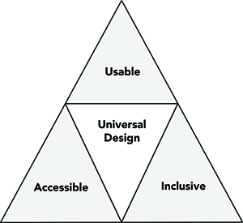
What New Faculty Need to Know Later
Include a syllabus accessibility statement
Respond to and review accommodation letters
Create email template & basic plan of action
Document discussion in writing
Manage accommodations to CEA Faculty Login
Incorporate Universal Design principles

Slide 24
Handout of Resources
CEA Website: http://cea.uark.edu
Faculty information/resources on accommodations, operations and procedures
Intermittent Adjustment to Attendance and Coursework Plan
The CEA is a resource for faculty; consult regarding any access concerns.
IMPORTANT UPDATE:
In July 2022, Testing Services assumed the management of the Union Station Test Center, located in SDPG 305.
Primary location for accommodated test proctoring is at 97 N. Razorback Road.
For questions/concerns or assistance requesting services, contact Testing Services at testing@uark.edu or (479) 575-3948.

Slide 25
Diversity Perspectives

Slide 26
Welcome
U of A Cares/Dean of Students
Andrea Allan
Director, U of A Cares

Slide 27
What New Faculty Need to Know Now
U of A Cares can assist students experiencing crises (personal, academic, financial)
Referring to U of A Cares ensures students receive personalized outreach
U of A Cares does not provide class excuses

Slide 28
What New Faculty Need to Know Later
U of A Cares will encourage students to work directly with professors on extensions/incomplete requests
Outreach from U of A Cares is not prescriptive or meant to provide directives to faculty.

Slide 29
Handout of Resources
https://uofacares.uark.edu/
Please visit the U of A Cares website for additional information, resources, or to submit a U of A Cares report.
You can also reach U of A Cares anytime by emailing uacares@uark.edu or 479-575-5004.

Slide 30
Welcome
Office of Academic Initiatives and Integrity
Chris Bryson
Executive Director

Slide 31
What New Faculty Need to Know Now
Academic Integrity is valued at the U of A
Current policy enacted in 2012 by faculty senate
Mandates that all faculty report to central office
Academic Integrity Monitors in each college investigate
Instructor input/options throughout process
Sanction Rubric ensures consistency & addresses patterns of behavior

Slide 32
What New Faculty Need to Know Later
Reporting Advice
Call to consult in advance & lean on the policy
Reporting form can be found at honesty.uark.edu
Case resolution timeline & a 6% recidivism rate
A Challenging Environment for Instructors
Partnering with the TFSC and TIPs

Slide 33
Handout of Resources Academic Initiatives and Integrity
Visit our website (honesty.uark.edu) to learn more about the policy, access resources (such as syllabi statements), and insight from faculty that have served as AIMs and Board members. We are here to help you – please don’t hesitate to reach out with questions.
Chris Bryson
Executive Director
CORD 341
Phone: 575-2989
Email: bryson@uark.edu
Office of Academic Initiatives and Integrity
3rd Floor of the CORD
Phone: 575-5229
Email: honesty@uark.edu

Slide 34
Welcome
Student Success at The CORD
Trevor Francis
Associate Vice Provost/Director for Student Success

Slide 35
What New Faculty Need to Know Now
Campus-wide and targeted academic support
We proactively reach out to students
Anxiety and depression common/treatable
Remind students of Bloom’s Taxonomy
We are here to support you and your students

Slide 36
What New Faculty Need to Know Later
Stress management and test taking strategies
One-time persistence scholarships
Academic recovery plans and programs
Major and career exploration
We are here to support you and your students

Slide 37
Handout of Resources Student Success
Student Success: success.uark.edu
One Stop Student Guide: onestop.uark.edu
Academic Advising Services: advising.uark.edu

Slide 38
Welcome
TIPS - Teaching Innovation & Pedagogical Support
Kathryn Zawisza Abi Moser
Director of Academic Technology Blackboard Support Coordinator IT Services Global Campus

Slide 39
What New Faculty Need to Know Now
We are here to help with technology!
Getting Started with all tech!
(IT Services) its.uark.edu/get-started
Faculty & Student Emergency Support
Help.uark.edu
479-575-HELP
bbhelp@uark.edu
Faculty Teaching Tech Consultations & Brainstorming
tips@uark.edu
tips.uark.edu

Slide 40
What New Faculty Need to Know Later
Tools we support
Blackboard Learn (LMS)
Kaltura
Echo360
Zoom
Collaborate Ultra
Respondus LockDown Browser & Monitor
And more!
Research software & support
Cybersecurity checklist

Slide 41
Handout of Resources Teaching, Innovation, and Pedagogical Support
Teaching Innovation and Pedagogical Support (TIPS) is a partnership between the University of Arkansas’ Wally Cordes Teaching and Faculty Support Center (TFSC), IT Services, and Global Campus. We focus on academic technology and teaching support. Our goal is to collaborate across campus in order to promote faculty development and enhance student success.
Contact Us
For teaching technology consultations, brainstorming, and non-emergency support stop by our offices in the Cordia Harrington Center for Excellence (CORD 301 and 302), send us an email at tips@uark.edu, or schedule a session with the TIPS team!
Want to do it yourself? Visit tips.uark.edu for detailed instructions on technologies.
For Emergency Support, please contact the IT Help Desk at 479-575-HELP, visit help.uark.edu, or email bbhelp@uark.edu.
For Student Support, please have them call the IT Help Desk at 479-575-HELP or visit help.uark.edu, or email bbhelp@uark.edu. Additionally, student FAQs can be found at bbhelp.uark.edu.
Need to know where to start with technology? Get started here! https://its.uark.edu/get-started/
Sign up to receive our teaching newsletter!
We support Blackboard Learn, Zoom, Collaborate Ultra, Echo360, Kaltura, Respondus LockDown Browser & Monitor, VoiceThread, Publisher Content, and more!

Slide 42
Welcome
University Libraries
Adriana Gonzalez
Associate Dean for Research and Learning

Slide 43
What New Faculty Need to Know Now
We have 4 libraries
Mullins (main), Physics, Chemistry, Fine Arts
You have a discipline librarian who supports your
research and teaching
We support Open Education Resources and Open Access
publishing support
You have access to robust collections

Slide 44
What New Faculty Need to Know Later
Renovation Phase 2
interactive and user-centered spaces
Looking to collaborate
Global Campus, Student Success Center
New discovery tool
One Search
New spaces
faculty reading room and carrels, flex space, graduate reading room, group study spaces

Slide 45
Handout of Resources
Libraries Website: https://libraries.uark.edu/
Librarians: https://libraries.uark.edu/about/personnel/specialists.php
OER: https://libraries.uark.edu/oer/
Spaces: https://libraries.uark.edu/rooms/
Fun Facts: https://libraries.uark.edu/about/

Slide 46
Department of Equal Opportunity, Compliance and Title IX
Department of Equal Opportunity, Compliance, and Title IX (OEOC) Danielle Williams, Associate Vice Chancellor/Executive Director | Title IX Office Shanita Pettaway Director of Title IX Compliance and Title IX Coordinator | EO/ Grievance Office Danielle Williams, Associate Vice Chancellor/Executive Director, Compliance Officer | Office of Accommodation and Accessibility Services J’onnelle Colbert-Diaz, Director of Accommodation and Accessibility Services/ADA Coordinator

Slide 47
What New Faculty Need to Know Now
Title IX
Oversees University compliance with Title IX, which prohibits sex, gender identity, and/or sexual orientation based discrimination, including, but not limited to: pregnancy-related discrimination, sexual harassment, sexual assault, domestic and dating violence, and stalking in all activities and programs of educational institutions receiving federal funds, which includes the University of Arkansas

Slide 48
What New Faculty Need to Know Now
EO/ Grievance Office
Assists the campus community in upholding the principle of equal opportunity in education and employment by enforcing the University’s Non-Discrimination (Including Discriminatory Harassment) policy by providing education, consultation, and by investigating allegations of discrimination/discriminatory harassment.
For workplace concerns that are not discriminatory in nature, we assist appointed employees by encouraging fair, efficient, and equitable solutions by facilitating the Staff Grievance Procedure.

Slide 49
What New Faculty Need To Know Later
The process of addressing complaints consists of:
• Meeting with the involved parties
• Thoroughly explaining the complaint and investigation process
• Offering supportive measures/resources (ex: counseling, medical, or academic assistance)
• Taking the appropriate avenues for resolution

Slide 50
What New Faculty Need to Know Later
All complaints or reports of sexual misconduct and discrimination can be submitted by the following:
Electronically at: report.uark.edu
Staff Grievance Procedure and reporting any kind of discrimination or harassment is located on the OEOC website.
Contact Title IX Office at: titleix@uark.edu
(479) 575-7111
Contact EO/Grievance Office at: titlevii@uark.edu
(479) 575-4019

Slide 51
Faculty Panel
Fiona Goggins, AFLS
Lorraine Brewer, ARSC
John Gauch, ENGR
Molly Rapert, WCOB
Tyrone Washington, COEHP

Slide 52
Faculty Panel
What do you wish you knew as a new faculty?
Tips on overcoming challenges
Tips on getting involved in community
Advice about service
Tips on time management

Slide 53
Welcome from the Chancellor
Charles Robinson, Interim Chancellor

Slide 54
What Now?
Lunch (Pick up in hall and eat in here)
Watch photos of faculty showing their favorite places to go in Northwest Arkansas
Shake hands with the Chancellor
Take your photo with the Razorbug
Attend the Resource Fair
Fill out the Evaluation Form
Grab an Ice Cream

